Slide 1
JT Batch Projects
PAR/NIST Cooperative
Eric Robertson

Slide 2
Adhoc Batch Tool
Works in three modes:
Start with initial images -> create projects
Start with projects -> run plugin on last image found in each project
Start with projects and images with same name as project -> connect image to last image of each project labeling with given operation information
Dis-advantages?
Produces single line of manipulations projects, thus it cannot support Paste Splice.
Need to run all projects in collective stages, rather start and finish one project at a time.
Advantages?
Alleviates need to craft a project descriptor.
Does not introduce randomness to image selection.
Can extend existing projects

Slide 3
Batch Projects
Unlike the Adhoc Batch Tool, Batch Projects creates a complete projects from start to finish.
Batch Projects performs manipulations with plugins.
Batch Projects selects images from a pool of images (without replacement).
The Batch Project graph mirror the final JT projects. What’s the difference?
A Node is a plugin (operation)
A link is a dependency, defines order of operation.

Slide 4
Batch JT
Process Graph
Operation Nodes:
Select Image: Provided a pool (directory) of images
Base Selection: Same as Select Image, except start new project using the selected image name.
Plugin: Execute a plugin operation to create a new manipulated image. Requires consistent parameters.
Input Mask Plugin: Execute a plugin on a image to produce an (input) mask and any additional name/value pairs to be used to as parameters in subsequent operations. Input masks highlight groups of pixels (full intensity) as constraints to other plugins.
NodeAttachment: Base node for extending existing journals
PreProcessedMediaOperation: Represent an operation already completed, providing a target file.
Base
Selection
Select
Image
Plugin
Plugin: Select Region
Plugin
Plugin
Plugin
Plugin
Plugin:
Paste Splice
Operation Parameters :
- Includes donor images, fixed values, masks, etc.
Links (edges):
- Form the dependency tree and order operation execution.
Each produced journal graph reflects the same structure as the process graph.
Plugin
Notes:
Randomize the filter types…blur, high/low pass filters,
Accomodate filters saying what operation they performed...

Slide 5
JSON
SHELL
{ "directed": true, "graph": { "username": "ericrobertson", "name": "sample", "organization": "PAR" ”recompress” : true
}, "nodes": [ ], "links": [ ], "multigraph": false }
Name should be unique
Re-apply JPEG or TIFF compression, given base image meta-data, to all final image nodes
List of nodes
List of dependency edges
Node
{ "op_type": "BaseSelection", "image_directory": "tests/images", "picklist": "imageset", "id": "0" },
One of several possible operations
Operation specific parameters
If should match the position of the node in the node list for consistency and clarity
Link
{ "source": 0, "target": 2 },
Identification of source and target nodes, in the order they appear in the ‘nodes’ list.

Slide 6
Operations
BaseSelection
Select an image from a pool of images maintained in a directory. The base selection provides a single image used to start a new project. The selected image provides the name of the project. The image is expected to serve as a (the) base image for the project that is to be manipulated. There must be one and only one BaseSelection node; it must not have any predecessor nodes.
Parameters:
"image_directory” = a directory of a pool of ONLY images to select from (randomly)
“filetypes” = a list of files types to select from the image directory. This is optional.
"picklist": an in memory structure tracking the names of image files already picked from projects to prevent future selection. A file is created with the same name in the ‘working directory’, retaining the pick list selection across multiple independent and sequential batch runs.
ImageSelection
Select an image from a pool of images maintained in a directory. Like BaseSelection, an ImageSelection node most not have any predecessor nodes. Unlike BaseSelection, multiple ImageSelection nodes are permitted.
Parameters:
The parameters are the same as the BaseSelection. The image directory and picklist can use the same pool as other ImageSelection and BaseSelection nodes.

Slide 7
Operations
PluginOperation
Invoke a plugin
Produce a manipulated target image given a source image.
Parameters:
“plugin” = the name of the plugin
“arguments” = the set of arguments to be provided to the plugin. Each argument as a type and supporting descriptions. Arguments fill both the requirements of the plugin and the requirements of the operation definition.
InputMaskPluginOperation
Invoke a plugin
Produce an input mask and any additional name/value pairs based on the source image.
Parameters:
“plugin” = the name of the plugin
“arguments” = the set of arguments to be provided to the plugin. Each argument as a type and supporting descriptions. Arguments fill both the requirements of the plugin and the requirements of the operation definition.

Slide 8
Operations
NodeAttachment
Represent a ‘base’ node for existing project
Attach to a node of an existing project given rules provided to the tool’s command line.
PreProcessedMediaOperation
Consume results from an external operation.
Plugin is external. The result image is located based the name of the source.
Parameters:
“directory” = target directory of media
“argument file” = name of CSV containing argument values associated with the operation.
“argument names” = a list of argument names associated with columns 2 through N of the argument file. Column 1 is the media file name.
“op” = the JT operation name
“software” = the software used to create the target files
“software version” = the version of the software used to create the target files
“description” = the description of the software operation

Slide 9
Plugin Review
Plugins are operations.
Plugins are provided:
Filename of source image
Filename of target image
Additional arguments
Plugins action:
Overwrite target image
Optionally return name/value pairs that may be used as to set parameters of subsequent plugins.
What is special about the input mask plugin?
Given a source image, pre-selects a group of pixels for alteration but subsequent operations.

Slide 10
Sample Plugins
Name | Description | Additional Parameters
SelectRegion | Select a region from a source image. Add an alpha channel, setting the unselected pixels to 0.
PasteSplice | Place a selected region in a source image. Try to paste in area with the least amount of variance. Resize and rotate the selected region as necessary to fit into the selected area. | “Donor” image
SaveAsPNG | Save source image as a PNG. If the source image has EXIF metadata that contains Orientation and the parameter ‘Image Rotated’ is yes, rotate the image. | “Image Rotated”
GaussianBlur | Blur the entire image or a selected region of the image, given an optional input mask. | “kernelsize” is a tuple (x,y). The default value is (5,5). “inputmaskname” is the name of a monochrome image file where black pixels indicate the region to blur. The default is blur the entire image

Slide 11
Argument Types
Argument Name
"inputimagename" : { "type" : "imagefile", "source" :"4“ }
Each argument is a map containing a set of properties
including a type.
imagefile = select an image produced by another node. The source node is provided using it’s node id.
{ "type" : "imagefile", "source" :"4" }
mask= select an image mask produced by another node. Diff masks are specific to an edge: a source and target node pair. An edge is identified by source and target node ids. The mask is used by some plugins to identify areas to adjust.
{ "type" : “mask", "source" :"4" “target" :“6“
}
value=provide a specific value
"Image Rotated" : { "type" : "value", "value" :"yes" }
donor=pick resulting image from a predecessor node. ‘source‘ is optional.
”input" : { "type" : ”donor", “source”:”3”
}
list=pick from a set of values
”subject" : { "type" : ”list", "values" :[”other”, “landscape”]
}
Map Structure

Slide 12
Argument Types Cont.
variable = select an output name/value pair from a predecessor plugin node. The source node is provided using it’s node id. The pair’s value is identified by the name
“box_to_alter “: { "type" : “variable", “name" : “box_altered“,
"source" :"4" }
input= identifies the name of input image file (input mask) from the output (target) image of another plugin.
“inputmask“ : { "type" : “input", “source" :“6“
}
plugin=call a plugin function registered through the Python setuptool‘s entry point maskgen_specs. The function name is the entry point name. The function accepts a dictionary of parameters, provided in the definition.
”kernel" : { "type" : ”plugin”,
“name" : “kernel_builder“,
”parameters" : { “kernel_size”: 5}
Int[low:high]=pick a value, uniform distribution over the range, inclusive.
”kernal_size" : { "type" : ”int[1:100]”
}
float[low:high]=pick a value, gaussian distribution over the range, inclusive
”percent_change" : { "type" : ”float[0.0:1.0]”
}
yesyno=pick yes or no
”color_correct" : { "type" : ”yesno”
}

Slide 13
Example JSON
{ "directed": true, "graph": { "username": "ericrobertson", "name": "sample", "organization": "PAR" }, "nodes": [ { "op_type": "BaseSelection", "image_directory": "tests/images",
"filtypes": [”jpg”],
"picklist": "imageset", "id": "0" }, { "op_type": "ImageSelection", "image_directory": "tests/images", "picklist": "imageset", "id": "1" }, { "op_type": "PluginOperation", "plugin": "SaveAsPNG", "picklist": "imageset", "id": "2", "arguments": { "Image Rotated" : { "type" : "value", "value" :"yes" } } },
{ "op_type": "PluginOperation", "plugin": "SaveAsPNG", "picklist": "imageset", "id": "3", "arguments": { "Image Rotated" : { "type" : "value", "value" :"yes" } } }, { "op_type": "PluginOperation", "plugin": "SelectRegion", "id": "4", "arguments": {} }, { "op_type": "PluginOperation", "plugin": "PasteSplice", "id": "5", "arguments": { ”donor" : { "type" : ”donor", } } },
{ "op_type": "PluginOperation", "plugin": "GaussianBlur", "id": "6", "arguments": { "inputmaskname" : { "type" : "mask", "source" :"2", "target": "5” } } } ], "links": [ { "source": 0, "target": 2 }, { "source": 1, "target": 3 }, { "source": 3, "target": 4 },
{ "source": 2, "target": 5 }, { "source": 4, "target": 5 }, { "source": 5, "target": 6 } ], "multigraph": false }

Slide 14
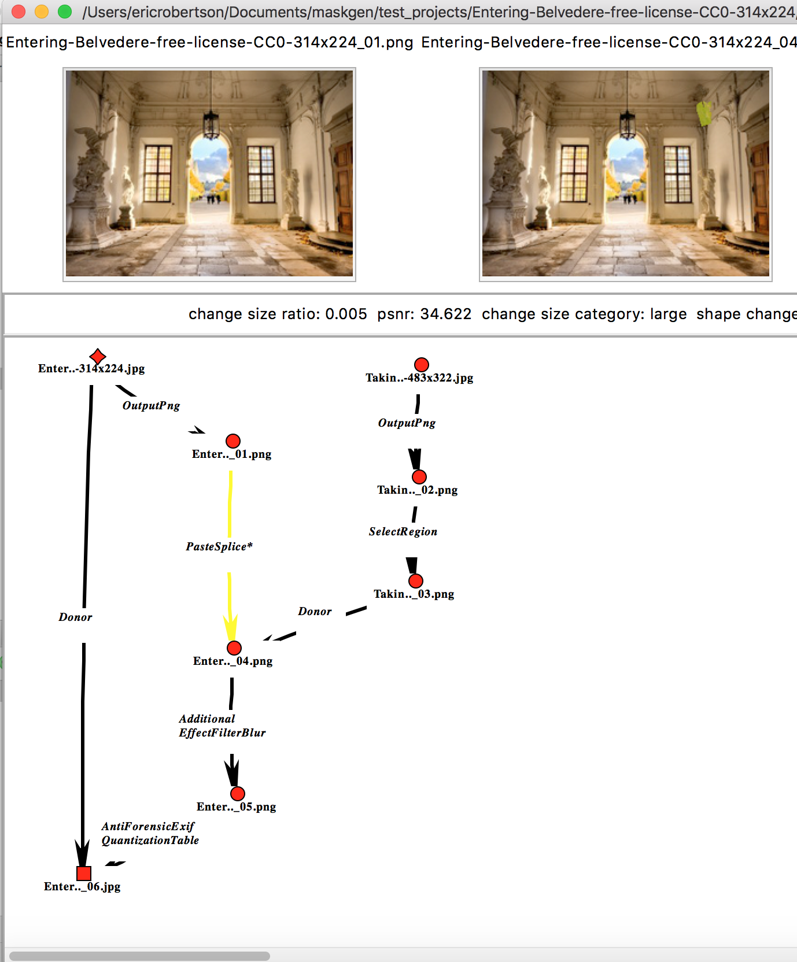
Graph View
Process Graph
Base
Selection
Select
Image
Plugin:
SaveAsPNG
Plugin:
SaveAsPNG
Plugin:
PasteSplice
Plugin:
SelectRegion
Plugin:
GaussianBlur
Plugin:
CompressAs
‘recompress’ is true

Slide 15
Running
Install JT
Make sure the directory to place the created projects exists (e.g. tests/test_projects).
Example Command Line:
Jtproject --count 2 --results tests/test_projects --json tests/batch_process.json --loglevel 0
Arguments
Mandatory
results = directory to hold completed projects
json = the batch process JSON description file
Optional
count = number of projects to build.
Make sure count < number of images in the select image directory
By default, just creates one.
A value of 0 is used with the ‘graph’ option.
loglevel = 0 to 50 log level, 0 being finest
graph = create a Graphviz layout. File name is the name of the batch process + ‘.png’.
threads = number of threads to run, building project in parallel (one thread per project). Default is 1.

Slide 16
Using the InputMaskPlugin
Process Graph
Enable pre-selection of pixels to manipulate by succeeding operation nodes.
In this example, identify regions to blur using a plugin that identifies faces.
Journal Graph
Base
Selection
123.png
InputMaskPlugin:
FindAFace
blur
Plugin:
Blur
123_1.png

Slide 17
Installing Plugin Functions
Plugin functions are used to set parameters for operations.
Create separate project and install it with the user-defined function. The key piece is the following in setup.py:
entry_points=
{'maskgen_specs': [
’foo = myplugin.foo:getLength'
]
},
Install the project (python setup.py install)
The name foo is used in as the item name of the plugin type argument specification.
This is a pseudo-name for the function getLength() in the package myplugin.foo. The entry point name maskgen_specs is a locator for the JT batch to discover these plug-in specification functions.
Example Operation Node Definition:
"id": "MaskSelect",
"op_type": "InputMaskPluginOperation",
"arguments": {
"percentage_width": {
"type": "plugin",
"name" : "foo",
"parameters" : {"param1" : "whatever"}
}

Slide 18
Paste Splice Options
There are a number of plugins available to aid in Paste Splice. The example project specification tests/batch_process.json under maskgen contains an example paste splice configuration.
In the example, the SelectRegion plugin uses Felzenszwalb to segment the source image to find a spliced object. By default. The PasteSplice plugin places a select image o a random selected area in the target image.
PasteSplice supports a complex placement solution using either SLIC or Felzenszwalb to select a placement region of some uniformity (texture). It includes rescale and rotation as needed, to fit the pasted object into the selected placement region. Naturally, this approach is slower. This option is turned on by setting ‘approach’ to ’texture’ on the PasteSplice plugin (show below).
{
"op_type": "PluginOperation",
"plugin": "PasteSplice",
"id": "5",
"arguments": {
“approach": {
"type": "value"
"value": “texture"
}
"donor" : {
"type": "donor"
},
...
“approach": {
“segment": "value"
"value": “felzenszwalb"
}
}
}

Slide 19
Options on Paste Splice
The 'approach’ argument is one of 'texture', 'simple', or 'random’. A random selection includes rotation and scaling
Segmentation Algorithms used with the texture approach are set by the ‘segment’ argument. The ‘segment’ argument is one of 'felzenszwalb’ and ’slic’.
Since the transform matrix for the donor mask is calculated, the plugin places the actual transform matrix into the arguments of the PasteSplice edge in the project JSON. This may be of aid to training algorithms.

Slide 20
SelectRegion plugin
This plugin uses Felzenszwalb to segmented selected image. It does not allow the user to specify the size in pixels of the selected region.
By default, the plugin is assumed to select a region for donation into another image, producing an RGBA image where the alpha channel indicates the select region.
When alpha is set to no, the plugin is used a image selection plugin, saving the result as a mask rather than RGBA image.
{
"op_type": "PluginOperation",
"arguments": {
"alpha": {
"type": "value",
"value": "yes"
}
},
"plugin": “Selection"
},

Slide 21
SmartMaskSelector plugin
The SmartMaskSelector uses a SLIC for segmentating of the source image. It allows the user to specify the size in pixels of the selected region.
It supports small, medium and large sizes. The size parameter (1 through 3) randomly selects on of the sizes. The ‘op’ parameter selects between random box or SLICed segment selector.
The plugin can act in place of the SelectRegion plugin, used prior to a PasteSplice as the tool to select the donor image.
When alpha is set to no or absent, the plugin is used a image selection plugin, saving the result as a mask rather than RGBA image.
{
"op_type": "PluginOperation",
"arguments": {
"mediumh": {
"type": "int[64:128]"
},
"smallw": {
"type": "int[32:64]"
},
"largew": {
"type": "int[128:512]"
},
"largeh": {
"type": "int[128:512]"
},
"op": {
"type": "int[1:2]"
},
NOTE: You can force the parameters to a specific value. Suppose you want only small selections with a box shape (without segmentation):
{
"id": "4",
"op_type": “PluginOperation",
"arguments": {
...
"op": {
"type": "value",
"value":1
…
"size": {
"plugin": "SmartMaskSelector"
},
"smallh": {
"type": "int[32:64]"
},
"size": {
"type": "int[1:3]"
},
"mediumw": {
"type": "int[64:128]"
},
"alpha": {
"type": "value",
"value": "yes"
}
},
"plugin": "SmartMaskSelector"
},

Slide 22
Pre Segmented Images
Another option for selecting region is the PreSegmentedSelectionRegion plugin. The plugin is designed to be used with a custom segmentation algorithm, like a deep learning approach. The intent is to have a set of images pre segmented, each with an associated RGB mask image that color codes the regions of the segmented images.
Each output mask has the same name as the image (suffix with .png), and is placed in a separate directory. Within that same directory, a classification.csv file contains the mappings of color to subject descriptor, in accordance the theSelectRegion journaling categorization ("people","face","natural object","man-made object","large man-made object","landscape",”other”).
The arguments to the plugin into the segmented mask directory (segmentation_directory) and the color to use (color). The color is optional. In its absence, one will be chosen at random given the available classification colors in the chosen image.

Slide 23
Design Paste Clone
The DesignPasteClone plugin support paste sampled cloning. It requires in an input mask of the indicated the pixels to be cloned and a location (upper right corner) to paste the cloned region.
It is used in conjunction with either the SelectionRegion or SmartMaskSelector plugins (alpha) configured as InputMaskPluginOperations as the source of the input mask, paste_x and paste_y argument values.
"id": "DesignPasteClone1",
"op_type": "PluginOperation",
"arguments": {
"inputmaskname": {
"source": "CloneMaskSelect",
"type": "input",
"description": "localized selector"
},
"paste_y": {
"source": "CloneMaskSelect",
"type": "variable",
"name": "paste_y",
"description": "localized y position paste"
},
"paste_x": {
"source": "CloneMaskSelect",
"type": "variable",
"name": "paste_x",
"description": "localized x position paste"
},
"purpose": {
"type": "value",
"value": "clone"
}
},
"experiment_id": null,
"plugin": "DesignPasteClone"
},

Slide 24

Using External Batch Processes
Batch project mimics batch process functionality using the PreProcessedMediaOperation operation.
The batch specification describes the set of operations and provides details to locate the results.
Supports complex batch integration, including donations.
Base
Selection
Initial Media
Target Project
Produced Media
PrePro
PrePro
Produced Media
Projects
External Batch
Process Step 1
External Batch
Process Step 2

